Slide 1
SPLE – Solar Powered Laser Engraver
Realized by:
Niculae Alexia – “Tudor Vianu” National College of Computer Science
Cinca Ana – “Ion Neculce” National College

Slide 2
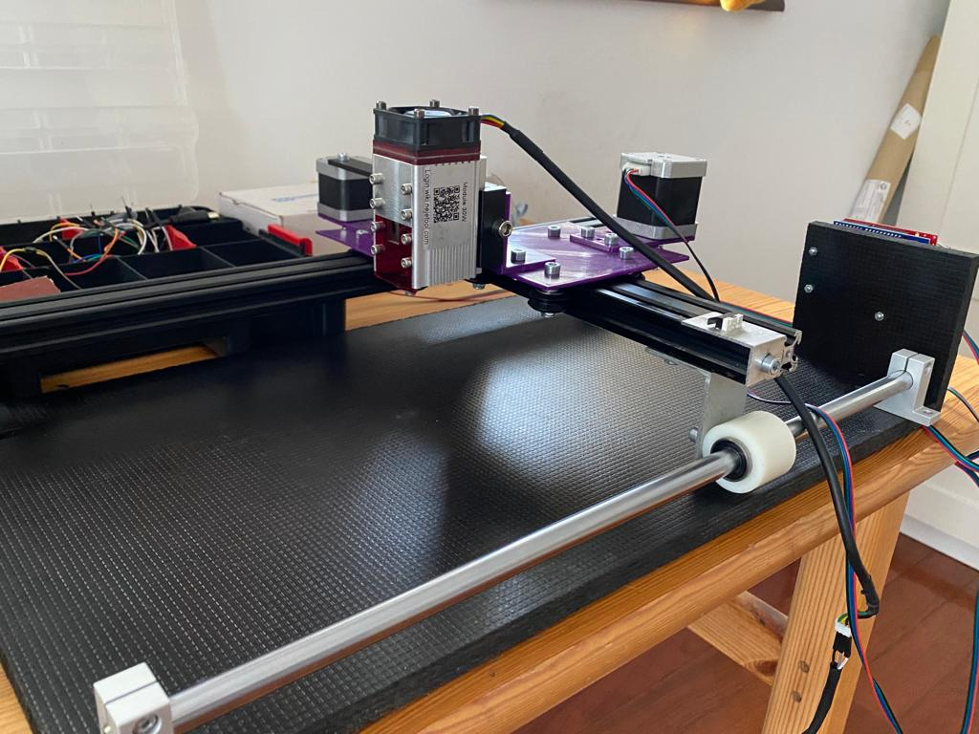

Slide 3
Table of contents
01
02
03
04
05
06
Original contributions and challenges
Proposed functionalities
Performance evaluation
Project testing
Similar Solutions
Further improvements

Slide 4
Table of contents
07
08
09
High level implementation details
Challenges
Contributions

Slide 5
01
Proposed functionalities

Slide 6
SPLE – Solar Powered Laser Engraver is a robot which can perform small to medium sized laser engravings on various materials, such as: wood, aluminium, carbon fiber, leather and cardboard. Depending on the capacity at which it’s being used and the intensity of the diode, the engravings can be either decorative or functional.

Slide 7
02
Original contributions and challenges

Slide 8
Original contributions:
Linear motion system
Powering system for the stepper motors
Charge system for the LiPo batteries
Micro stepping
Challenges:
Hole measurements and size of the Gantry Plates
Providing enough power to the motors
Maximizing workspace
Ensuring balance

Slide 9
03
Project testing Test Scenarios

Slide 10
Module | Scenario Description
Gantry Plates | Ensuring the durability and stability of the gantry plates; making sure the hole measurements are on point
Balance | Ensuring the machine is balanced and stable ensuring proper workflow
Linear Motion | Ensuring proper working of the linear motion
Laser Diode | Ensuring correct placement and distance from the workspace;
Engraving | Correct behavioral patterns depending on the intensity of the laser

Slide 11
04
Performance evaluation

Slide 12
Performace wise, the laser didn’t display any functionality errors and acted according to user input.
When used with an intensity of 9-20%, the machine only manages surface engravings on all the materials listed above.
When used with an intensity of 20-70% the engravings cut through the material (exception: aluminum)
Generally, the finished products do not display irregularities.
Additionally, with the implementation of micro stepping most of the noise is eliminated.

Slide 13
05
Comparison with other similar solutions

Slide 14
Compared with models such as NEJE Master 3 Plus and SCOLPFUN, SPLE has a similar working area, however balance is achieved using a linear rail guide instead of benefiting from motor placement. Additionally, the linear motion system is designed differently, using t-slot extrusion wheels for both the X and Y axis.

Slide 15
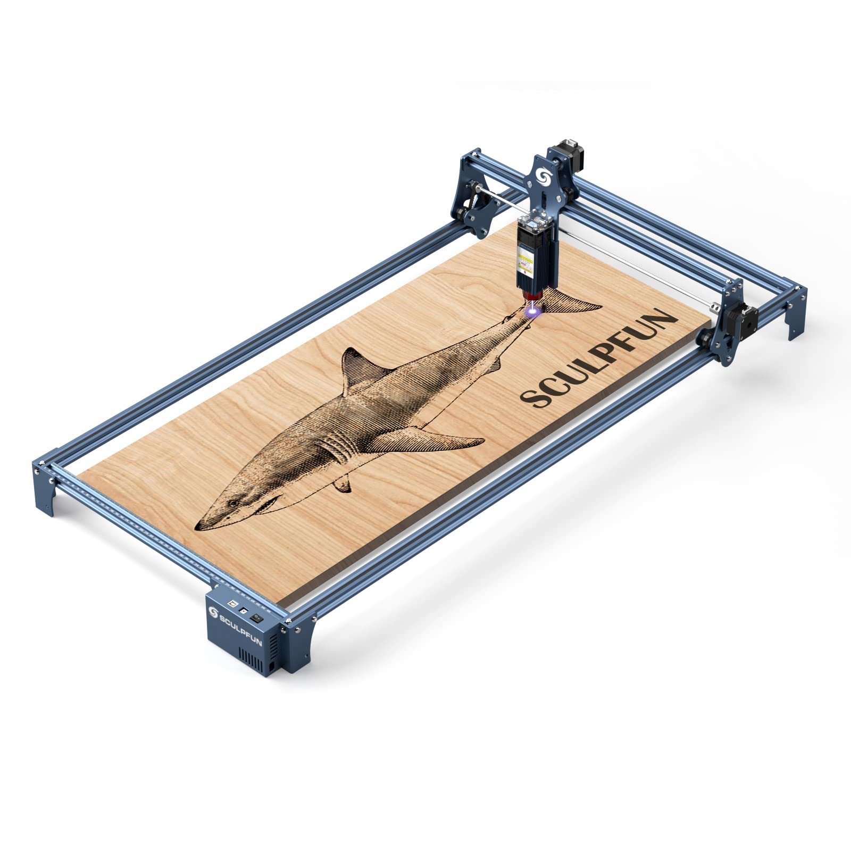
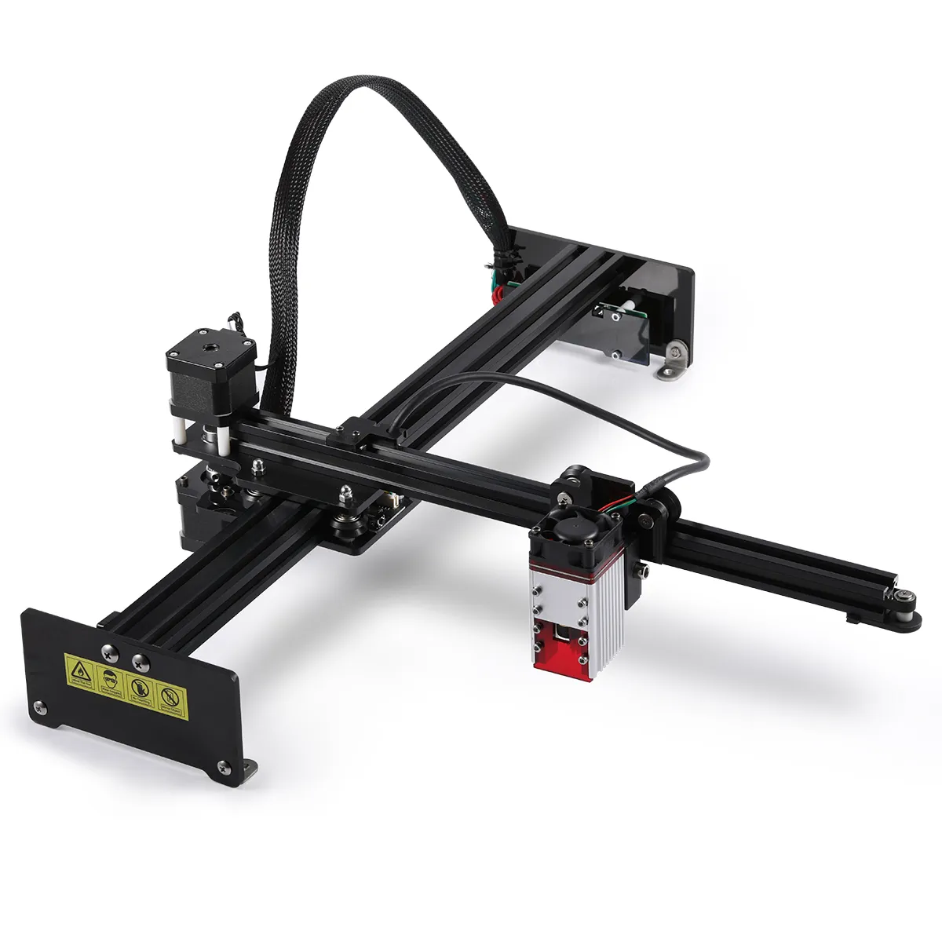

Slide 16
06
Possible further improvements

Slide 17
Powering the laser diode using LiPo accumulators, which can be charged using solar energy;
Switching to aluminum gantry plates, which are less malleable and heat resistant;
Creating a bigger working area;
Switching to a more powerful laser diode

Slide 18
07
High level implementation

Slide 19
Powered via the CNC shield (using 2 A4988 stepper motor drivers), the 2 Nema 17 stepper motors action the X and Y axis gantry plates by rotating the GT2 pulleys fixed on the motor shaft. The Y axis is fixed on the X axis by a 20x20 aluminum extrusion. Using this system, the laser is able to cover the the whole working area. To execute user input I used the GRBL library and the LaserGRBL UI interface. This allows me to transform any png/jpg into executable files and to control the intensity of the laser.

Slide 20
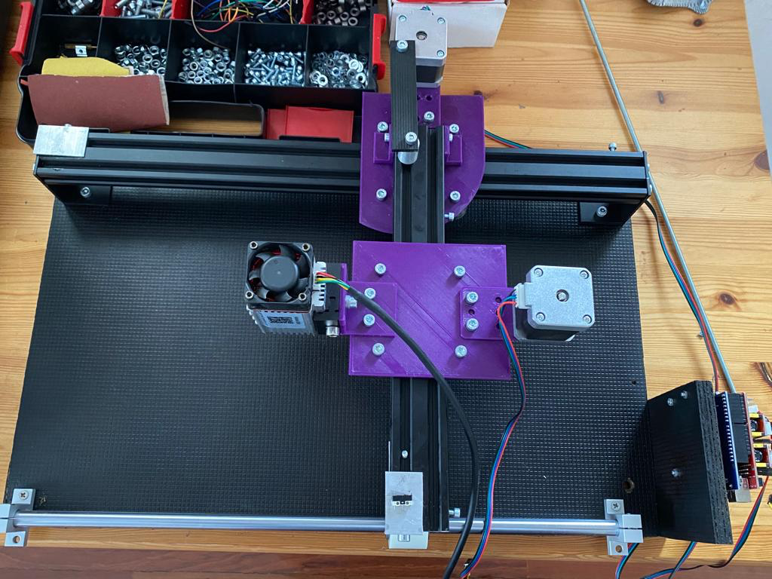
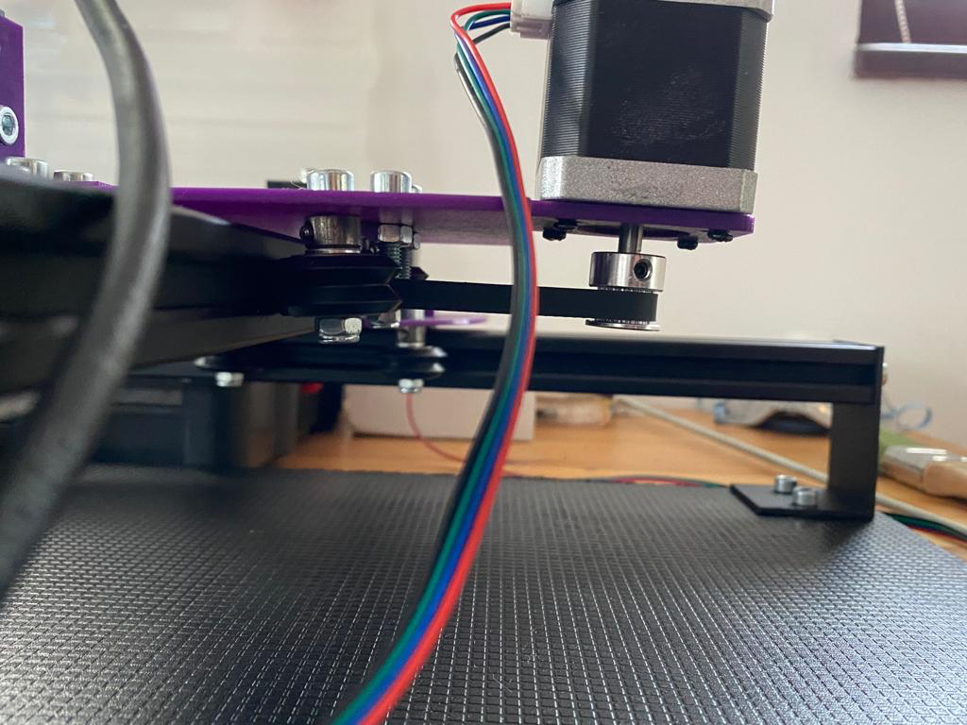

Slide 21
Methodology
X axis position
Y axis position
User Input
Laser intensity
Laser position

Slide 22
08
Challenges

Slide 23
One the hardest challenges while developing the project was ensuring that the stepper motors, powered via the Arduino and CNC shield, received enough power from the LiPo accumulators, which were charged using solar energy. To overcome this I ensured that the batteries provided enough current (1.8 A) for both motors to function properly, as well as creating an efficient charge system using a solar panel and a step-down voltage regulator.

Slide 24
09
Contributions

Slide 25
Contributions inspired by other models:
Universal Gantry Plate
Use of aluminum extrusions
GRBL library
LaserGRBL user interface
Powering the stepper motors via the CNC shield

Slide 26
Thanks!
Do you have any questions?
alexianiculae29@gmail.com (design + implementation)
anacinca24@gmail.com (marketing)
+40 724 556 222
+40 734 002 788
Please keep this slide for attribution

